Slide 1
Project Review 0: Comparison of TCP Variants over Routing Protocols in MANET

Slide 2
Team
Members
Under the guidance of
Dr. P. Varalakshmi
BATCH 1
N. Hemanth 2019503519
P. Ramyaa 2019503547
G V. Sudharsan 2019503565

Slide 3
OUR DOMAIN
Major: Comparison of TCP Variants over Routing Protocols in MANET
Minor: Analyzing over Proactive and Reactive Protocols.
IETF MANET (mobile ad hoc network) has standardized AODV (ad hoc on-demand distance vector) and OLSR (optimized link state routing) as its reactive and proactive routing protocols, respectively. As Transmission control protocol (TCP) was created for Internet with fundamentally different properties, faces serious challenges when used in mobile ad hoc networks. Research is still going on MANETs which involve efficient routing considering the fact that the topology changes so frequently over time. To improve TCP performance over ad hoc network, a lot of development and enhancement have been proposed. MANET is to be simulated using NS3 simulator for this research. Fairness of TCP variants analyzed in the simulation environment to understand how reactive and proactive routing protocol has facilitated TCP Variants operation.

Slide 4
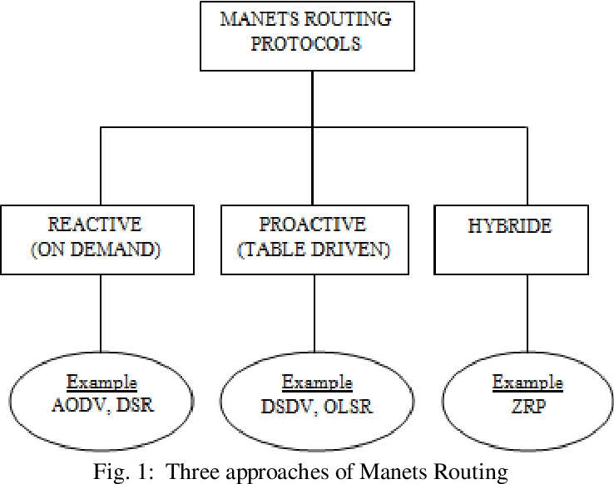
Topic Area Explanation
MANET and Protocols
A mobile ad hoc network (MANET) consists of mobile wireless nodes. The wireless communication between these mobile nodes is carried out in a decentralized autonomous system. The protocols to be used in MANET depend upon the capabilities of the devices, packet drop rate and other factors.
MANET requires efficient routing algorithm in order to reduce the amount of signaling introduced due to maintaining valid routes, and thus, enhances the overall performance of the MANET system.

Slide 5
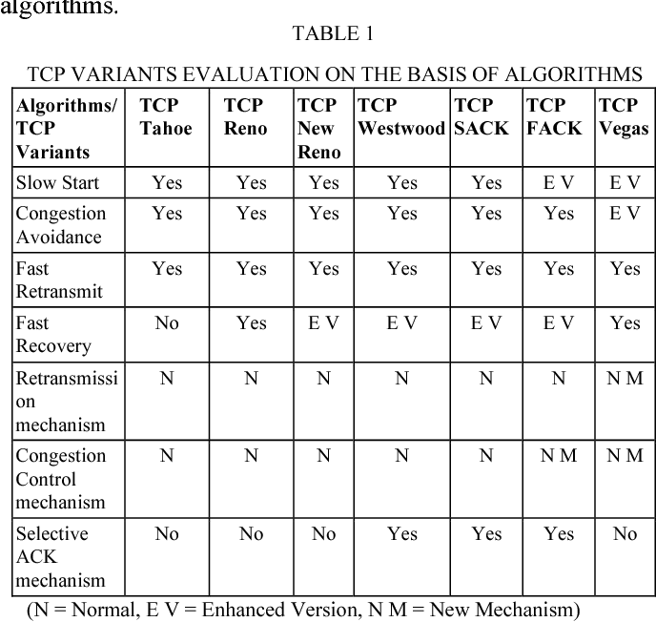
Topic Area Explanation
TCP Variants
TCP is the most reliable transport layer protocol that provides reliable data delivery from source to destination node. TCP is less preferred for ad-hoc networks, however, TCP can be modified to improve its performance.
TCP uses Congestion Control Algorithms. TCP occur in distinct variants that incorporate TCP Tahoe, Reno, New Reno, Vegas and Dynamic Vegas. Every of this TCP variant has its characteristics and drawbacks.

Slide 6
Need for the project
A MANET does not have a fixed infrastructure. Nodes are mobile so topology keeps on changing. TCP as explained above does not perform well in wireless networks, because of frequent path breaks, multipath routing, network partitioning, hence congestion control is the main issue for MANETs. If no proper approach is followed for controlling the congestion, it may even collapse the network. Since different TCP variants work on different strategies, it is necessary to identify the best performing TCP variant in MANET over various protocols. This area has not been explored to its maximum potential, and hence, research may be conducted for establishing a basis for development of new protocols for the purpose mentioned.
Project Goals
Study the performance of the routing protocols dealing with TCP variants.
To determine the best TCP Variants in MANET environment over renowned routing protocols
To propose a novel idea and also compare TCP Variants with this techniques in order to enhance the efficiency of the ad hoc network.

Slide 7
LITERATURE SURVEY 1
Comparative study of TCP variants for congestion control in wireless network by Pooja Chaudhary , Sachin Kumar IEEE 2017
This paper demonstrates the basic congestion control strategy. There have been many variations in TCP algorithms originating from the essential TCP which has exclusively Slow Start and Congestion Avoidance mechanism to the variation and extension of latest mechanism.. Every TCP variant has its characteristics and drawbacks. This paper describes the comparative study of five TCP variants such as TCP Tahoe, TCP Reno, TCP New Reno, TCP Vegas and TCP Dynamic Vegas, their slow start ,congestion avoidance and Congestion detection algorithm and also analyze the best extensively used TCP variant abstractly and further investigate the possible future research field. In several packet losses, the behavior of TCP New Reno is best. The shortcoming with TCP New Reno is that it hold single RTT to discover packet deficit. TCP Vegas perform best in high congested network, it recognize congestion before it arise. But still there are many issues in TCP Vegas, when TCP Vegas share a same bottleneck connection with TCP Reno, it build rerouting, fairness problem.
https://ieeexplore.ieee.org/document/8229880

Slide 8
LITERATURE SURVEY 2
Performance Survey of MANET Routing Protocols with TCP Congestion Control Algorithms by Suparna Banerjee; Arindam Ghosh; Sourav Mahapatra; Raja Karmakar IEEE 2020
The paper in consideration have discussed about the different categories of routing protocols and also, different TCP congestion control algorithms used in MANET routing. The application of MANETs in wireless mobile communication is evolving as an instinctive preference due to its ability to support high mobility, high scalability and very low administration, which are the essential characteristics of advanced wireless mobile communications. The research carried out here, shows the Quality of Service (QoS) lies in the performance of the routing protocols used. In this paper, they have presented a survey on the performance of different routing protocols under Transmission Control Protocol (TCP) congestion control algorithms with an objective to study the performance of the routing protocols in absence or presence of the TCP congestion control algorithms from existing literature. This paper reviews the immense importance of congestion control algorithms in MANET environment.
https://ieeexplore.ieee.org/document/9290610

Slide 9
LITERATURE SURVEY 3
A Comprehensive Analysis and Comparison of TCP Tahoe, TCP Reno and TCP Lite by Poonam Tomar, Prashant Panse IEEE 2012
There are various TCP variants and each one belongs to a different criteria. In this paper, author has discussed about the congestion problem in ad hoc networks and compare the performance of three TCP variants that all work on different techniques. This paper compares TCP variants specifically TCP Tahoe, Reno and Lite based on different parameters such as number of nodes received with error, packet loss, byte received, and throughput and pause time. A table is then drawn which shows the comparison results. Some of protocols show better response and some of them show poor responsiveness to changing network conditions and network utilization. Although there are various protocols and algorithms that have been used, there is no single algorithm that can overcome the congested and unreliable nature of network. In short, any protocol will be effective based on the parameters that are to be taken into consideration. Every variant has totally different mechanism to manage congestion in network.
https://www.researchgate.net/publication/267712138_A_Comprehensive_Analysis_and_Comparison_of_TCP_Tahoe_TCP_Reno_and_TCP_Lite

Slide 10
LITERATURE SURVEY 4
Performance analysis of different TCP variants in wireless ad hoc networks by Sharada U Shenoy; M Sharmila Kumari; Udaya Kumar K Shenoy; N Anusha IEEE 2017
In this paper the author has performed a comparative analysis of the TCP variants - TCP Tahoe, TCP Reno, TCP New Reno over routing protocols – AODV, DSDV and DSR using the NS-2 network simulator. These results can be further used to conduct any experiments with proper combinations of TCP and routing protocols. It can be noted that in each of the performance studies (PDR and throughput), DSR do better with TCP New Reno. Therefore the paper concludes that performance of DSR protocol is best suited while compared with AODV for applications with large number of nodes in MANETs. Performance of DSDV protocol is not satisfactory with any TCP variant. In scenarios of large ad hoc networks, DSR with TCP New Reno can be a good combination of transport and routing protocols to be used. DSDV is not preferably good for this scenario.
https://ieeexplore.ieee.org/abstract/document/8058308

Slide 11
Existing Works in the Field
Various existing researches have been carried out and improvised variants of TCP by only one or two measures, have been proposed. These proposed measures do not seem to be sufficient for proper analysis of improvised version of TCP. Therefore, in this paper, our objective is to evaluate the performance of different TCP variants and their results are investigated to be with different renowned (DSDV, AODV, OLSR, etc.) routing protocols, and propose the best performance tcp variant over which of the routing protocol.
Existing works in the field of MANETs compare different routing protocols on the basis of only few of the performance measures. Despite the fact that considerable simulation work has been done, still more investigation is needed in the fairness of the TCP traffic and mobility models. Fairness issues of TCP Variants in MANET including existing routing protocol are still unsolved.

Slide 12
Gaps identified
The UDP traffic environment table is not clearly mentioned, in spite of effective explanation of drawbacks related to MANETS. The paper has no discussion about CBR environment and hybrid protocol, which might seem to be the research gap in the particular version. Also, analysis has been done for network with static nodes where there will not be any issues of link breakages due to node mobility.
MANET network under TCP variations(TCP Tahoe, TCP Lite, and TCP Reno) using DSR routing protocol. Used NS2 by way of the imitation instrument towards education some performance parameters like packet loss, received bytes and Throughput when using FTP as network traffic with a different number of nodes. Some of TCP Protocols showed a high performance under some conditions. The conclusion of this comparison shows that none of the TCP variants can overcome the congestion of the network, each protocol can perform better under specific conditions.

Slide 13
Gaps identified
In, a working model of AODV as a routing protocol and analyzing its performance along with enhancing number of mobile nodes is proposed, but the proposed model is only for reactive protocols, and only AODV has been considered, which was optimized with load balancing. In few of papers cited in the reference section, Hybrid protocols are totally ignored, and performance metrics are not included and cited as required, since we cannot conclude on basis of one performance metric alone.
In few of the papers, the disadvantage of the AODV that there is a delay in routing because of route discovery process and a connection of bidirectional is needed in order to detect a single link, is neglected, which we will try to consider in the analysis of the various protocols.

Slide 14
Our Goal and Schedule
Our goal is to analyse the protocols based on different performance measures and convincingly derive at a evaluation of TCP Newreno, and suggest methods which will achieve better performance in terms of performance measures with some security features for providing quality of service networks.
Our methodology includes the analysis of various performance measures such as throughput, delay, packet drop, packet delivery ratio and number of acknowledgements. The simulation results are planned to be carried out by varying number of nodes in network simulator tool NS3.

Slide 15
Understand various theoretical concepts and explore NS3
Finish Comparison of variants and document the evaluation done
Finish documentation including final touches and conclude project
Week 1
Week 3
Week 5
Week 7
Week 9
Simulate basic variants of TCP and begin comparison process using the NS3 simulator
Produce an effective novel idea to enhance the efficiency of the ad hoc network with respect to congestion and losses

Slide 16
Simulate a wireless network where the nodes move randomly with TCP flows on simulation topology. Difficulty exists to analyse fairness of TCP flows using TCP variants over routing protocols based only on mathematical and theoretical calculations. Thus, The simulation of the MANET gives a better perspective which helps us to reveal parameters influence on the MANET’s behaviour, hopefully suggesting a better theoretical solution to deal with tcp congestion control and packet losses.
Tools Used
Network Simulator 3
ns-3 has been developed to provide an open, extensible network simulation platform, for networking research and education. ns-3 provides models of how packet data networks work and perform, and provides a simulation engine for users to conduct simulation experiments. Some of the reasons to use ns-3 include to perform studies that are more difficult or not possible to perform with real systems, to study system behavior in a highly controlled, reproducible environment, and to learn about how networks work. Users will note that the available model set in ns-3 focuses on modeling how Internet protocols and networks work, but ns-3 is not limited to Internet systems; several users are using ns-3 to model non-Internet-based systems.

Slide 17
Goals for next meeting
Explore NS-3.
Identify and simulate apropos parameters, performance metrics like varying number of nodes, throughput, packet delivery ratio based on which the performance of TCP variants fluctuate with the help of NS-3.

Slide 18
References
Comparative Analysis of TCP Variants using NS3.25 and Netanim on Ubuntu Version 16.04 Platform by Archita Saxena , Manish Choudhary 2017.
Vijaya and A. K. Rath, "Simulation and performance evaluation of AODV, DSDV and DSR in TCP and UDP environment," 2011 3rd International Conference on Electronics Computer Technology, vol. 6. IEEE, 2011.
Gnana Prakasi, O. S.; Varalakshmi, P. (2019). Decision Tree Based Routing Protocol (DTRP) for Reliable Path in MANET. Wireless Personal Communications, 2019
Performance of AODV Routing Protocol with Increasing the MANET Nodes and Its Effects on QoS of Mobile Ad Hoc Networks.
Molia, Hardik K.; Kothari, Amit D. (2018). TCP Variants for Mobile Adhoc Networks: Challenges and Solutions. Wireless Personal Communications.
Interaction between Internet Based TCP Variants and Routing Protocols in MANET Sukant Kishoro Bisoy and Prasant Kumar Patnaik 2014.
Bagwari, Ashish; Jee, Raman; Joshi, Pankaj; Bisht, Sourabh (2012). [IEEE 2012 International Conference on Communication Systems and Network Technologies (CSNT) - Rajkot, Gujarat, India (2012.05.11-2012.05.13)] 2012 International Conference
Reactive and Proactive Routing Strategies in Mobile Ad Hoc Network Md. Ibrahim Talukdar, Md. Sharif Hossen, 2021
Comparative analysis of TCP variants under DSDV routing protocol, Firdous Ul Rashid, 2017
Pooja Chaudhary, Sachin Kumar, PhD,” A Review of Comparative Analysis of TCP Variants for Congestion Control in Network”
End to End Delay Performance of Various TCP Variants in Mobile Ad hoc Networks, Harsimran Kour, H. Sinha, A. Bindal,2014
Ghassan A. Abed, Mahamod Ismail and Kasmiran Jumari, "Exploration and evaluation of traditional TCP congestion control techniques", 2012
Jyoti Grover, Anshul Mehta, “On Demand Multipath Routing Protocol for Emergency Ad Hoc Networks,” 2019 Conference
Gawas, Mahadev A., Lucy J. Gudino, and K. R. Anupama,"Congestion-Adaptive and Delay-Sensitive Multirate Routing Protocol in MANETs: A Cross-Layer Approach,2019
X. Wang, K. Zheng et al., Novel Quick Sort (QS) approach for optimization of TCP in proceeding of Springer science business media, 2015.

Slide 19
Thank you

